Slide 1
Foundation of Data Science: Project Report
Mrinal Chaudhari
Introduction to Data Mining, 2nd Edition
by
Tan, Steinbach, Karpatne, Kumar

Slide 2
Preprocessing
used the ‘telecommuting’,’ has_company_logo’,’ has_questions’, ‘fraudulent’ column
These columns contains most valuable information for predicting fake news.
Dropped other irrelevant/less useful information for easier training and better performance.(title, location, description, requirements)
def test(data):
y = data["fraudulent"]
X = data.drop(['fraudulent'], axis=1)

Slide 3
Preprocessing
Feature selection
Remove unneccessary columns
def balance_data(data):
del data['title']
del data['location']
del data['description']
del data['requirements']

Slide 4
Model Training
Random forest classifier
Random forest classifier improve predictive accuracy.
classifier = RandomForestClassifier(n_estimators = 35)
def fit(self, X, y):
classifier.fit(X, y)
return

Slide 5
Prediction
Apply the preprocessor and learned model to predict whether a news is fake or not.
def predict(self, X):
predictions = classifier.predict(X)
return predictions

Slide 6
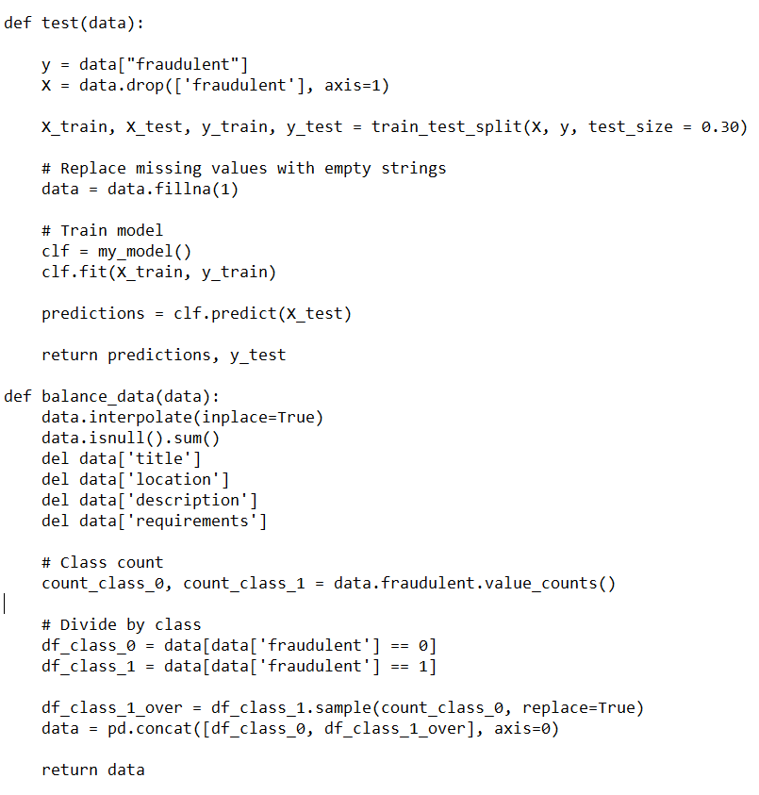
Model Evaluation
Oversampling
F1 score = 0.72

